Slide 1
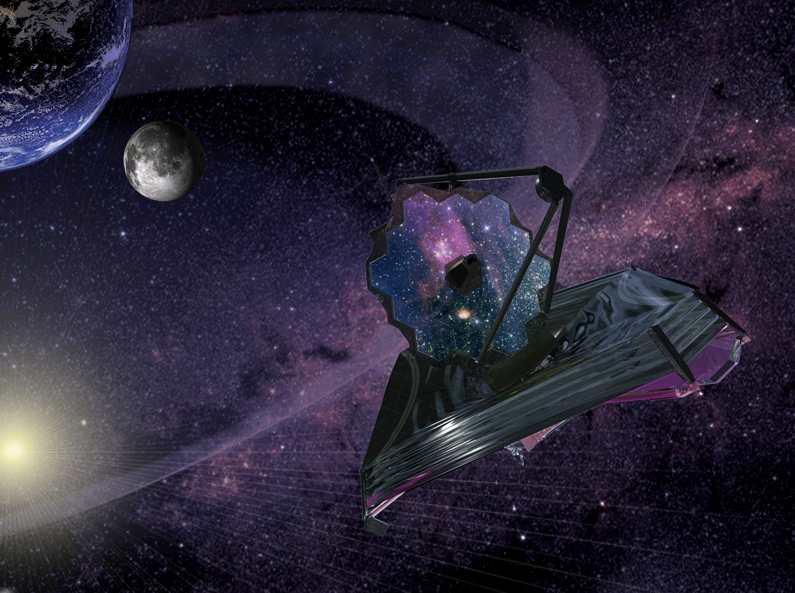
The Integration and Test Program of the James Webb Space Telescope
Randy Kimble¹
Pamela Davila¹, Charles Diaz¹, Lee Feinberg¹, Stuart Glazer¹, Gregory Jones², Rob Luetgens² James Marsh¹, Gary Matthews³, Douglas McGuffey¹, Pat O’Rear⁴, Deborah Ramey¹,
Carl Reis⁴, Tony Whitman³
¹ NASA/Goddard Space Flight Center
² Northrop Grumman Aerospace Systems
³ ITT Exelis
⁴ NASA/Johnson Space Center

Slide 2
Agenda
Present a high level overview of the JWST integration and test program
What are we doing from now until 2018?
Highlight some of the particularly noteworthy activities in that flow and the status of the test hardware to support them
Such as some extremely challenging cryo-vacuum tests
Present some of the key goals of those tests
This is just the tip of the iceberg of the meticulous systems engineering efforts that track the verification of requirements and validation of models over the course of the program
Point out some of the ways in which we’re laying out the program to reduce the risk in the major tests (technical and cost/schedule) and to streamline those activities

Slide 3
Philosophical Notes
As is typical, I&T for JWST is a hierarchical process
Lower level elements, developed and tested in parallel
Integrated into higher level assemblies and tested again
Subsystems → Science Instruments
Four Science Instruments + Electronics + Structure… → ISIM
ISIM + OTE → OTIS
OTIS + Spacecraft → Observatory
Verify performance requirements at the appropriate level of assembly
Try to catch problems at the lowest level possible (easiest to fix)
Provide independent cross-checks at the higher levels to confirm nothing went wrong in assembly
For an observatory as complex as JWST
There’s a lot of I….
There’s a lot of T….

Slide 4
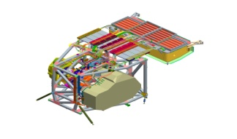
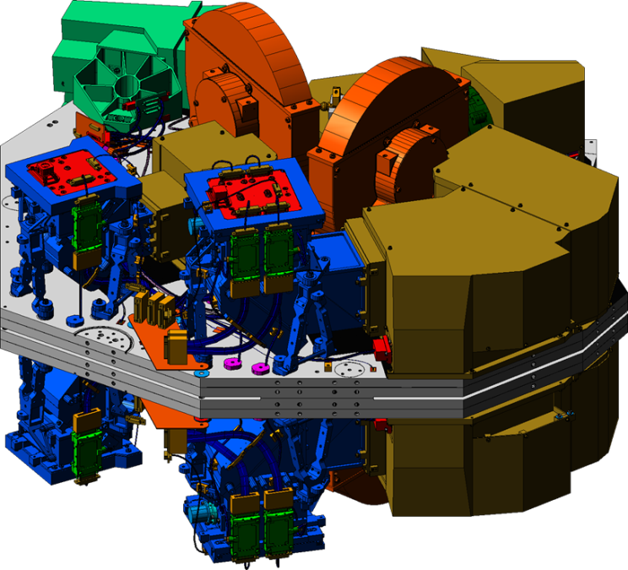
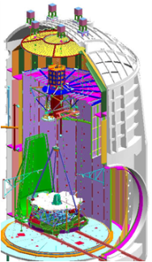
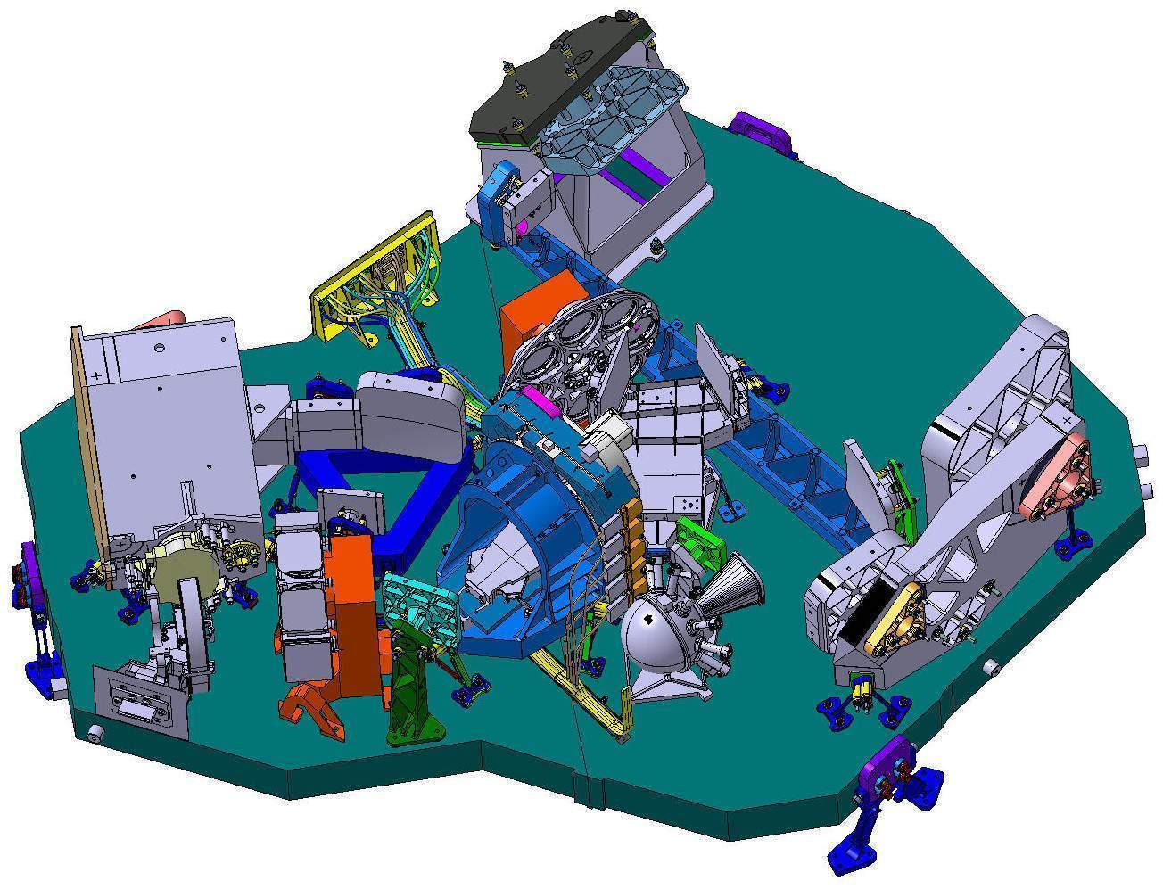
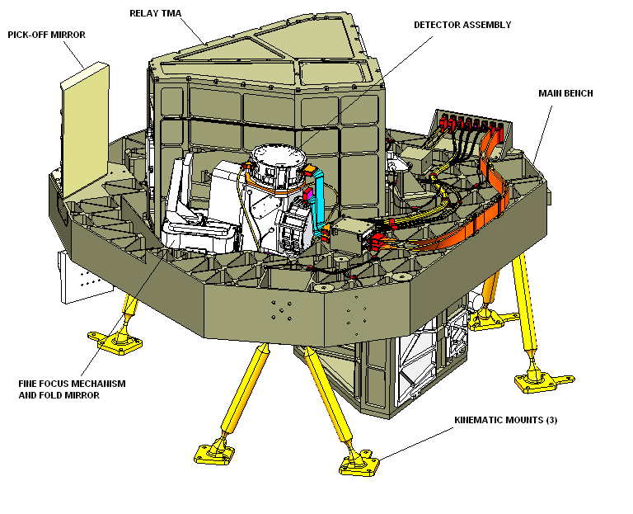
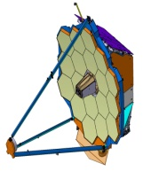
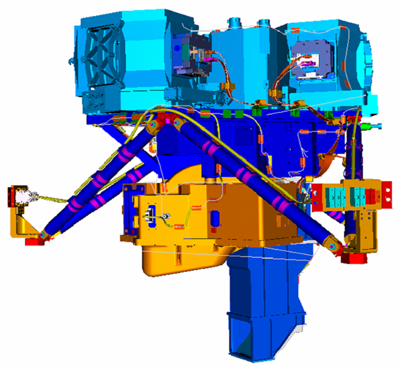
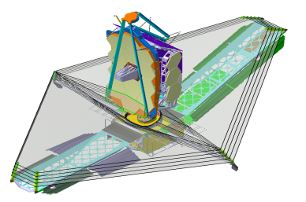
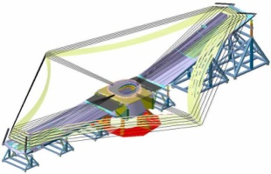
I&T Overview - Responsibilities
ISIM I&T
NIRCam
GSFC 29/SSDIF,15/SES,10
OTIS I&T
OTIS Ambient I&T
OTIS Cryo I&T
GSFC SSDIF, 10, 29
JSC 32
NIRSpec
Exelis Support
Exelis Support
FGS
NG Support
NG Support
OTE IPT
MIRI
OTE Structures I&T
OTE Optics
Integration
NGST M8
GSFC 29/SSDIF
Responsibility
Execution
Facility
NASA
NG
NG / Exelis
N/A
ESA / Ariane
Sunshield IPT
Sunshield I&T
NGST M8
Observatory I&T
Spacecraft Bus I&T
Spacecraft Element I&T
Final Observatory I&T
Launch Site I&T
LV Integrated Operations
Launch
NGST M8
NGST M8, M1 Vibe, M4 TV
NGST M8, LATF, M1 Vibe
CSG S5C, S5B, BAF, ZL3
ISIM Support
ISIM Support
6 July 2012
SPIE Astronomical Telescopes and Instrumentation: 8442-90
4

Slide 5
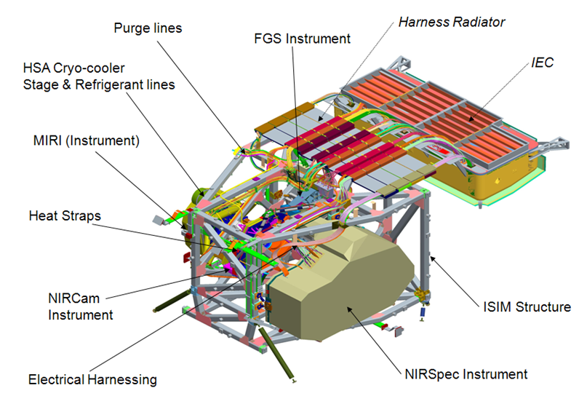
I&T of the Integrated Science Instrument Module (ISIM)
This activity is now well underway at GSFC, with the delivery to I&T of the ISIM structure, the first instrument (MIRI), and various electronics boxes (see Ray Lundquist’s talk later today)
A critical feature of the ISIM I&T program will be a series of cryo-vacuum tests in Goddard’s largest test chamber

Slide 6
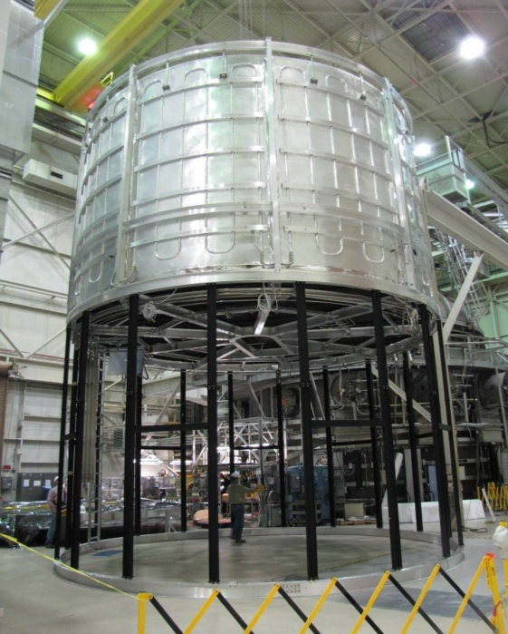
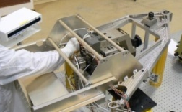
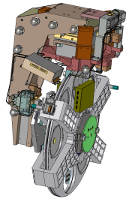
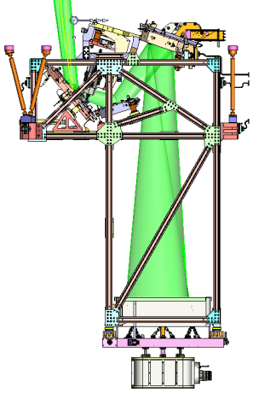
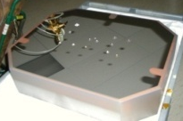
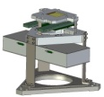
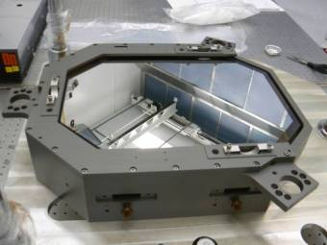
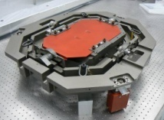
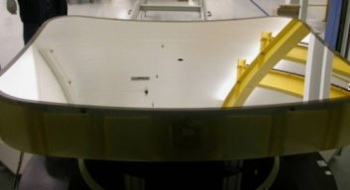
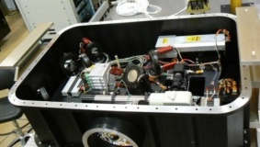
ISIM will be tested at ~35 K in the GSFC SES chamber using a cryogenic telescope simulator (OSIM)
SES chamber
(9m x 13m)
LN2 Shroud
GHe shroud
ISIM
OSIM
Vibration Isolation Supports
GHe shroud installation and test completed July 09
Fold Mirror 3 Tip/Tilt
Gimbal Assembly
Alignment Diagnostic Module
OSIM Primary Mirror

Slide 7
OTE Simulator (OSIM) with Beam Image Analyzer (BIA)
Space System Development & Integration Facility (SSDIF)
At NASA/Goddard Space Flight Center

Slide 8
OSIM Is Currently Warming from Its 1st Cryo-Vac Test
Photogrammetry Cameras
ISIM Test Platform (ITP)
BIA
Upper GESHA
He Shroud Region
LN2 Shroud Region
Vibration Isolators (3)

Slide 9
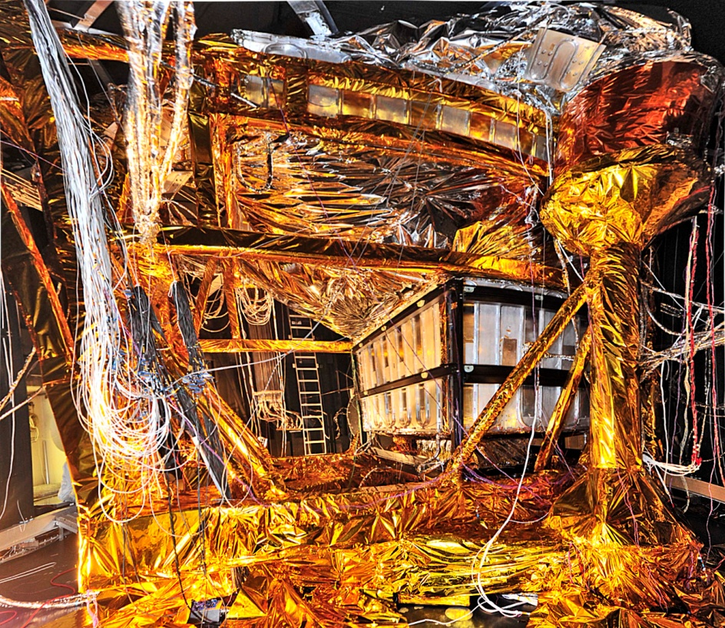
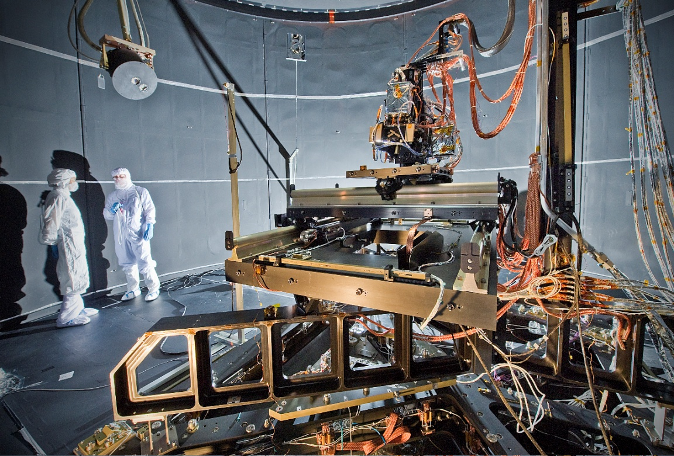
OSIM Cryo-Vac Confirms Its Optical Performance
OSIM performed very well at temperature
A cryo run early in 2013 just before first ISIM cryo-vac will be required to complete its certification
OSIM in the 100K section (bottom)
Beam Image Analyzer in the 30K section (top)

Slide 10
Key Aspects of the ISIM Cryo-Vac Program
The principal goals
Verify 6 degree-of-freedom alignment and pupil alignment of SI’s
Cross-check or verify SI image quality against OSIM
Verify wavefront sensing capabilities of the SI’s, obtain necessary calibrations
Verify thermal performance and correlate/validate thermal model
Verify performance with ISIM electrical systems, non-interference of SI’s with each other
Test ISIM operational scenarios, including the Onboard Script System
Trend SI performance

Slide 11
Modifications to the Baseline ISIM I&T Flow
Baseline ISIM I&T
Receive fully qualified and fully calibrated Science Instruments
Perform mechanical and electrical integration to ISIM systems
Perform two ISIM cryo-vacs, bracketing the rest of the environmental test program (vibration, acoustics, EMC), demonstrating the stability of the optical and thermal performance against those environmental inputs
Various issues have arisen that dictate modifications to that baseline
Principal is the need to replace the detectors in the 3 NIR instruments with more robust versions that will not be available until 2014
Delayed delivery of NIRSpec, flight MIRI Heat Exchanger Stage Assembly
Some NIRCam, NIRISS calibrations, verifications and one MIRI regression test have moved to ISIM level for greater efficiency

Slide 12
Current ISIM I&T Plan
Detector delivery in 2014 gives a no-earlier-than date in 2015 for final “run for the record” ISIM cryo verification run
We still want to get started with ISIM cryo runs as soon as possible
ISIM cryo-vac will be an extremely complex and challenging test
Want to discover any issues with the test setup or procedures as early as possible
Retire the (low) risk of issues with the deferred SI verifications as early as possible
Hence the currently planned ISIM I&T flow has 3 cryo-vac tests
Cryo-1 – spring 2013; a “risk mitigation” run with 3 flight SI’s, NIRSpec ETU, and a non-flight MIRI Heat Exchanger Stage Assembly (HSA)
Cryo-2 – 2014; all flight SI’s, HSA, original detectors (baseline is still to have vibe/acoustics between to demonstrate optical/thermal stability)
Cryo-3 – 2015; ISIM verification run for the record with all flight elements including new detectors; vibe/acoustics required between cryo-2 and cryo-3
Deliver fully qualified ISIM to OTIS (OTE + ISIM) integration; currently October 2015 (including ISIM-held margin) against need date of April 2016

Slide 13
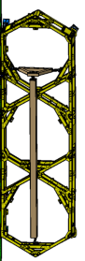
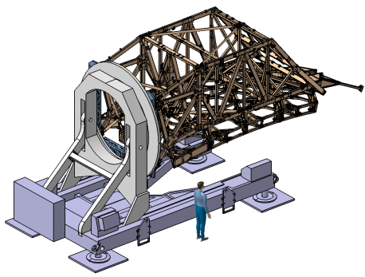
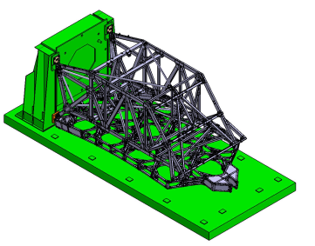
OTE Structure I&T @ NGAS
Integrate Wing Hardware
Wings
Latch pads/catches
LRMs
Harnesses (W20,21,17,18)
CJB
CMU 20-21
Cryo Diodes
BP Harnesses
06/2014
Remove PMBSS from STTARS
Harness/
Cyro Diode Installation
Transfer from ROF to VIS
Wing Installation
Wing Deployment
Testing
A
Route/Tape Diode harnesses
Install flight Diodes
Install flight PMBSS harnesses
Install flight OMNI harness
Rotate PMBSS to vertical
Separate HIF from ROF
Lift PMBSS w/ VLS (+V3) to VIS
Connect HIF to VIS
VIS ( +V3)
Survey CS
Latch pads
Clamp wing to CS
Alignment meas.
Repeat as needed
Latch installation
Drive/ Passive hinges
MLI
Batwing
Wing offload GSE
Test LRMs actuated
Deployment Test
Repeatability Test
Alignment measurement
Deploy Wings
Install Wing lockout Clamps
Lift to ROF
Lift to OSS Cup up
PMBSS
Receiving
Integration
Test
Prep & Shipping
6 July 2012
SPIE Astronomical Telescopes and Instrumentation: 8442-90
13

Slide 14
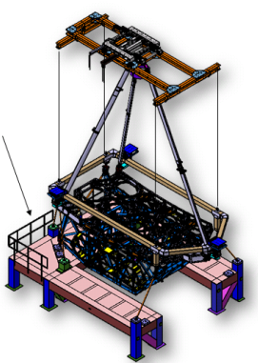
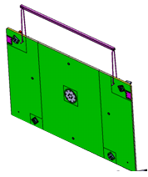
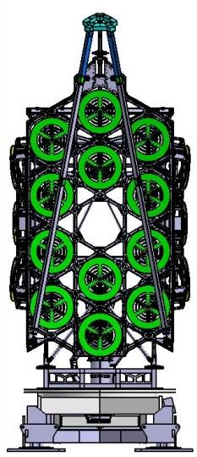
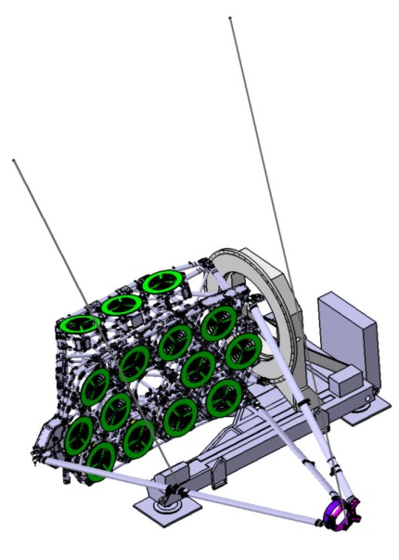
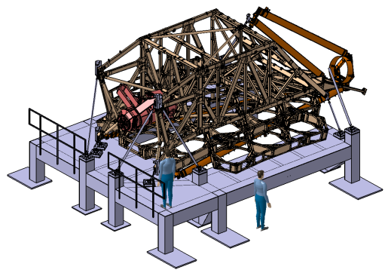
OTE Structure I&T
SMSS
PTR
Interceptor
CTA
DTA
A
Integrate SMSS
SMSS Deployment Test
Integrate DTA
Integrate
Mass Sims and PTR
DTA Deployment Test
B
OSS (+V1)
Lift from FAJ using HLS
Install SMSS
Stow
Alignment meas.
Stow
Install LRMs
Repeatability Test
Install SMA MS
Lift to ROF
ROF (-V2)
Attach slant lines
Test LRMs actuated
Motorized deployment
Monitor SGs, Resolver, & load cells
Repeat as needed
Powered Stow
Re-engage LRM bolts
Remove slant lines
Lift to OSS
OSS (-V1)
Install stowed DTA
Route Cooler Tower Assy. (CTA)
Alignment checks
Install OTE/IEC harnesses on DTA
(W33-41-46)
Install PTR -Interceptor Panel
OSS (-V1)
Install PMSA MS
AOS MS
ISIM MS (offload)
HR MS
ISIM Rad MSs
PTR –Interceptor Pnl
V2 PTR MSs
Mass Props
Lift to ROF
ROF (+V3)
DTA upper to lower tube alignment
DTA lower tube alignment to “M”
Test LRM actuated
Powered Deploy/stow
Strain gage readout/preload
Lift to VIS
6 July 2012
SPIE Astronomical Telescopes and Instrumentation: 8442-90
14

Slide 15
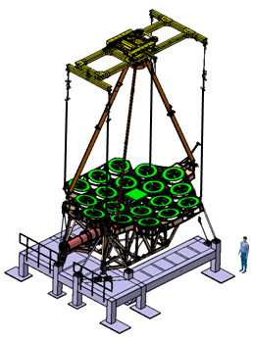
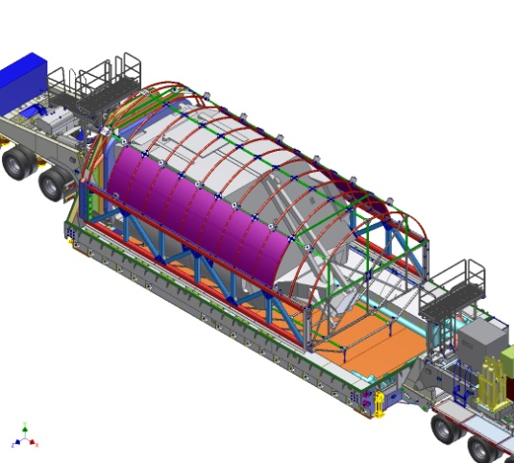
OTE Structure I&T
STTARS
C5-C Aircraft
04/06/15
Stowed Modal Survey
Deployed Modal Setup
Deployed Modal Survey
Remove Mass Simulators
Configure/ Ship to GSFC
B
VIS (+V3)
Install Accels
Snub DTA
Install stingers
Setup Scanning Laser Vibrometer (SLV)
Perform Test
Verify Results
Remove stingers, SLV
Deploy/Lockout Wings
Lift to ROF
Deploy DTA
Lift to OSS (TBD)
OSS (+V1) OR
ROF (+V1) TBD
Measure OTE CG
Walkout SMSS
Dis-enage motor
Install Stinger
Setup SLV
ROF (+V1)
Suspend w/ HLS
Perform Test
Suspend @ 2nd/3rd HPs
Perform Test
Verify Results
Stow SMSS
Remove SMA MS
Lift to OSS Cup down
OSS (-V1)
Remove MS PTR, HR, PMSA, ISIM, AOS, & Radiators
Stow DTA & Wings (+V3)
Remove PTR Interceptor Panel
Mass Properties
ROF (all orientations)
Cleaning operations
Install contamination covers & bags
Lift to Strongback
Install bag frame
Attach STTARS lid
Ship to GSFC
6 July 2012
SPIE Astronomical Telescopes and Instrumentation: 8442-90
15

Slide 16
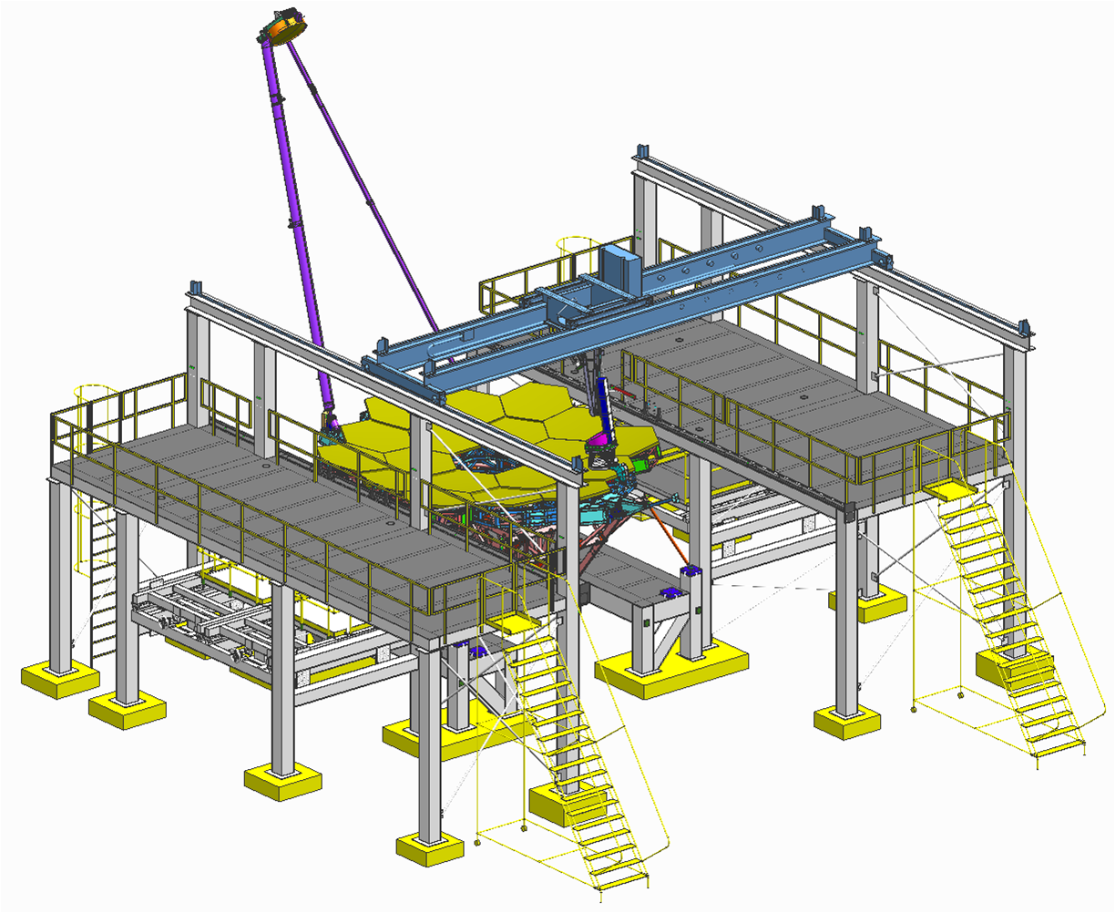
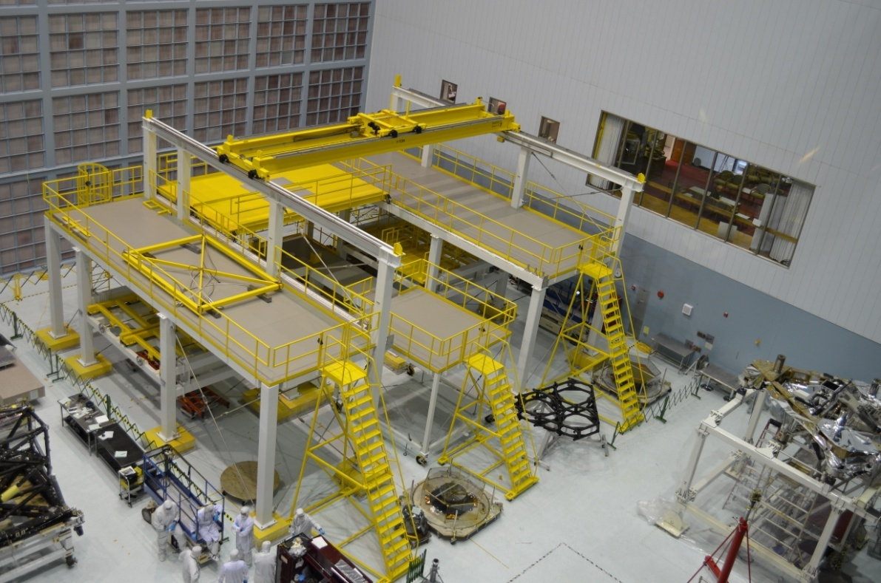
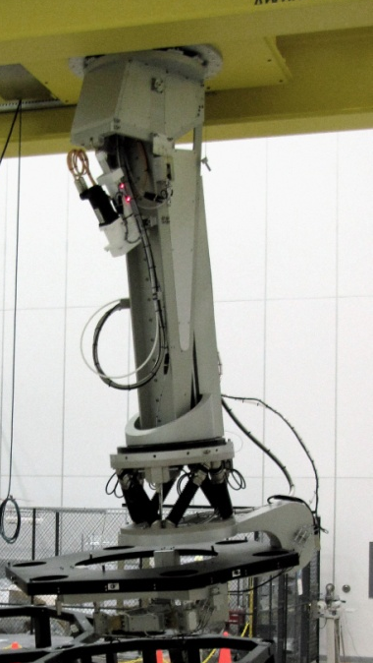
OTE Structure/Optics, ISIM Meet At GSFC for Ambient I&T
Ambient Optical Alignment Stand Complete
OTE structure and optics assembled in GSFC clean room on test stand above
ISIM then integrated to form OTIS (OTE + ISIM)
Vibe and acoustic tests at that level with pre- and post-test center of curvature measurements
Then off to JSC
Landing a primary mirror segment onto backplane simulator

Slide 17
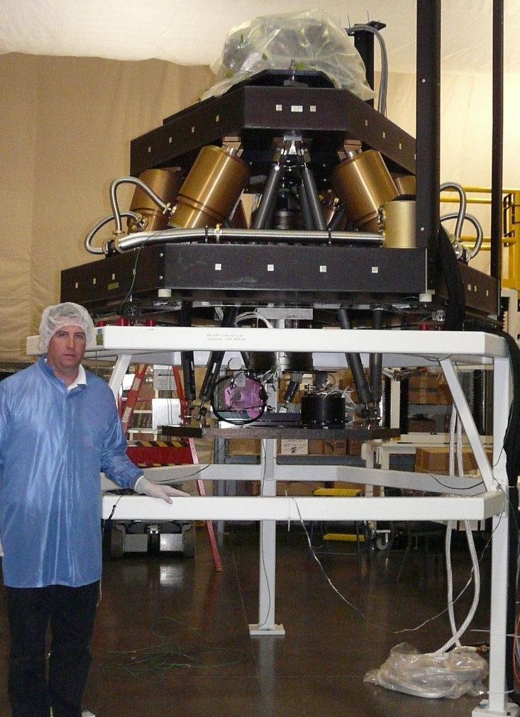
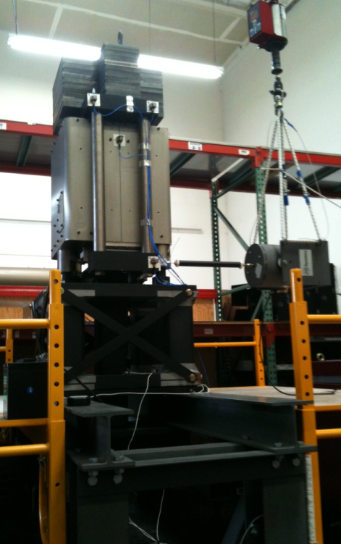
OTIS Testing in Historic Chamber A at JSC
Chamber Isolation
1st unit tested
Center of Curvature Optical Assembly (COCOA)
Well into its I&T
Suspension Subsystem
3 Autocollimating Flat Mirrors
1st unit complete.
Units 2 & 3 polished
Photogrammetry Windmills
Space Vehicle Thermal Simulator (SVTS) w/ cryo-cooler and electronics
AOS Source Plate
Hardpoint Offloader Support System
LN2 and Helium Cryogenic Shrouds and “barn door”

Slide 18
Key Aspects of the JSC OTIS Cryo-Vac Program
Optical goals
Verify critical fixed alignments – ISIM to AOS
Verify co-alignment to within budgeted actuation range for active primary and secondary mirror
Verify optical performance stability against expected thermal transients
Cross-checks of lower level testing
Thermal goals
Demonstrate that the hardware reaches expected temperatures and verify performance there, including end-to-end performance of the MIRI cryo-cooler, which ranges from the warm spacecraft to the cold ISIM
Collect thermal balance point data that is used to correlate and validate the OTE/ISIM thermal flight model (highly sensitive to workmanship)
Electrical, operational goals
Proper electrical operation of flight systems, cross-strapping, redundancy
Demonstration of key operations, e.g. Wavefront Sensing & Control, parity checks of guiding functions
Day-in-the-life operational script testing
A critical overall goal is model validation

Slide 19
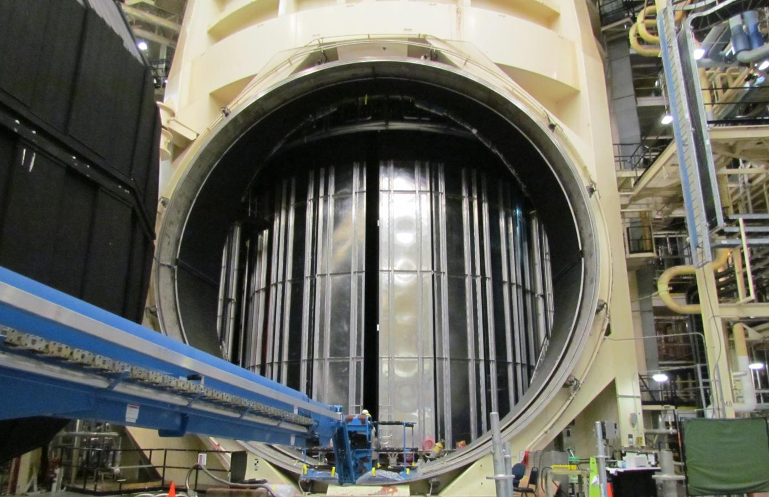
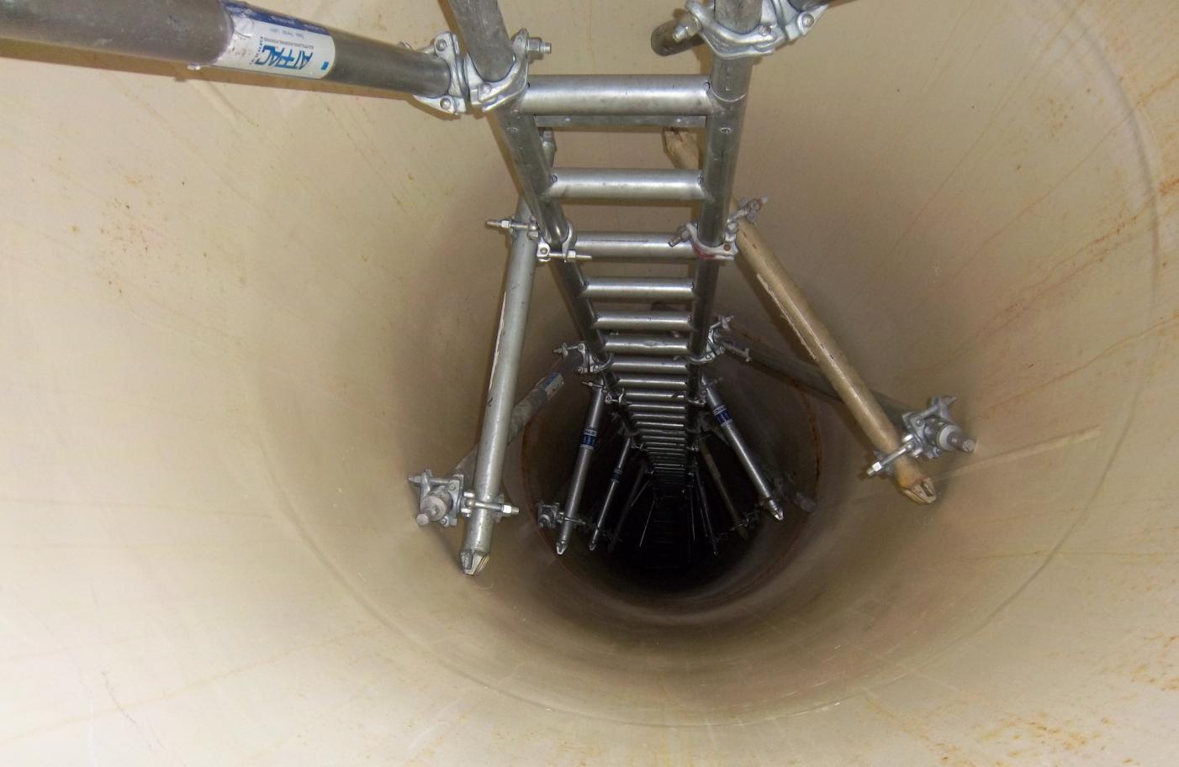
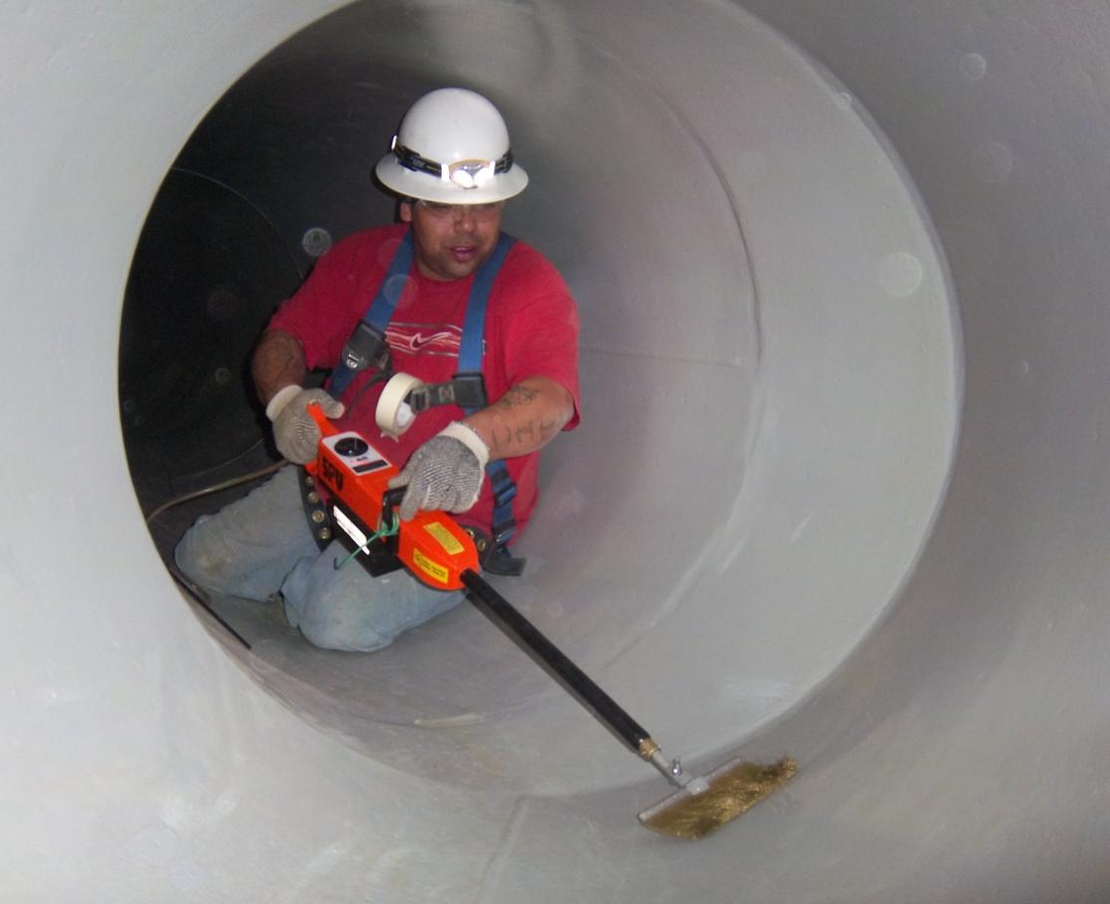
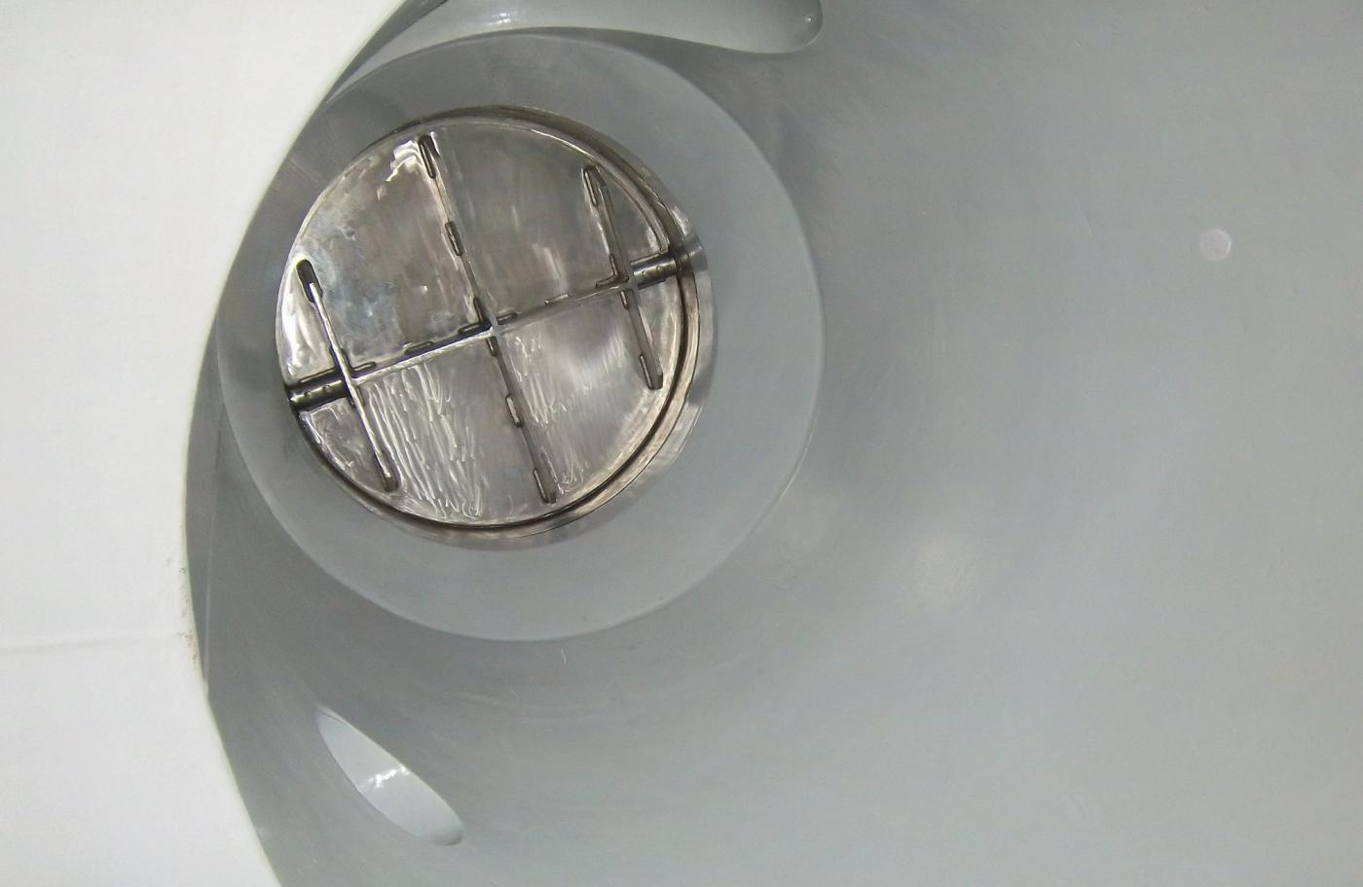
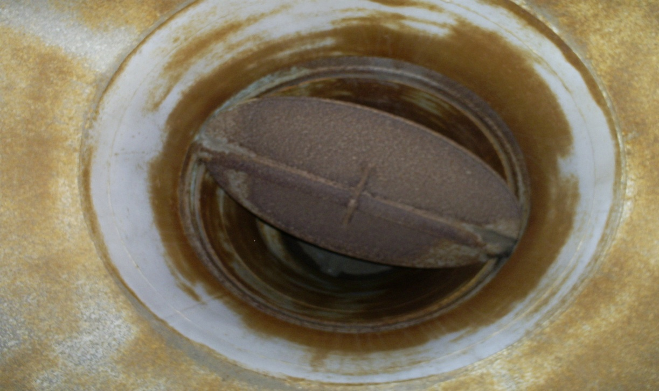
JSC Chamber A Modifications Are Nearly Complete
GHe Wall Shroud Jumper Installation
GHe Door Shroud Installation
After
Air Flow Management System: Large Bore Pipe Cleaning
Before

Slide 20
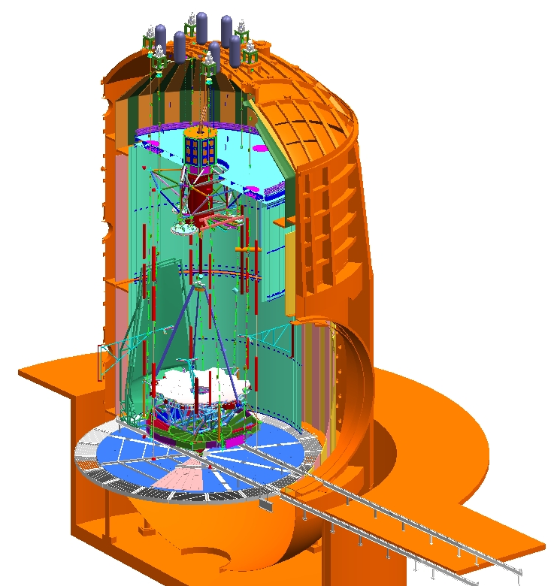
JSC Chamber A Modifications Are Nearly Complete
NITROGEN DISTRIBUTION
Provide 80K to 358K LN₂ to Shroud He Cold Box, Cryo Pumps
95% Complete – Installing final VJ Piping spools
AIR FLOW MANAGEMENT
Conditioning and Contamination Control of in-chamber air
85% Complete – Installing wiring and final large ducts
HELIUM DISTRIBUTION
Provide 15K to 333K gaseous He to the shroud
95% Complete – Installing final VJ Piping spools
HELIUM SHROUD
Provide 20 to 333 K environment to test article
100% Complete
HIGH VACUUM SYSTEM
Achieve 10⁻⁴ to ≤5x10⁻⁶ Torr
99% Complete – Installing final controls wiring
NITROGEN SHROUD
90 To 358 K environment and pumping capacity
95% Complete – Performing leak/pressure checks
POWER DISTRIBUTION
Normal and Backup Power inside and outside chamber
95% Complete – Check outs ongoing
RADIANT BARRIERS
Shield Shrouds from chamber walls
99% Complete – Floor close-outs remaining
RAIL SYSTEM
Support Test Article in Highbay and Chamber (100% complete - in storage)

Slide 21
Critical Optical GSE for OTIS Test
Coming Along Very Well, Led By ITT Exelis
Center of Curvature Optical Assembly (COCOA)
COCOA completed successful ambient optical testing and is well into cryo testing at MSFC
1st AutoCollimating Flat Assembly is complete; 2nd and 3rd polished
Vibration isolator tested; confirmed that can be tuned in place
Photogrammetry cameras are based closely on those used with great success (30 μm accuracy) in ISIM structure cryo-tests

Slide 22
JSC Test Facilities, GSE, Procedures Will Be Validated With Many Activities Before Flight OTIS Arrives
3/2014
7/2014
12/2014
Early 2017
7/2015
11/2015
3/2016
22

Slide 23
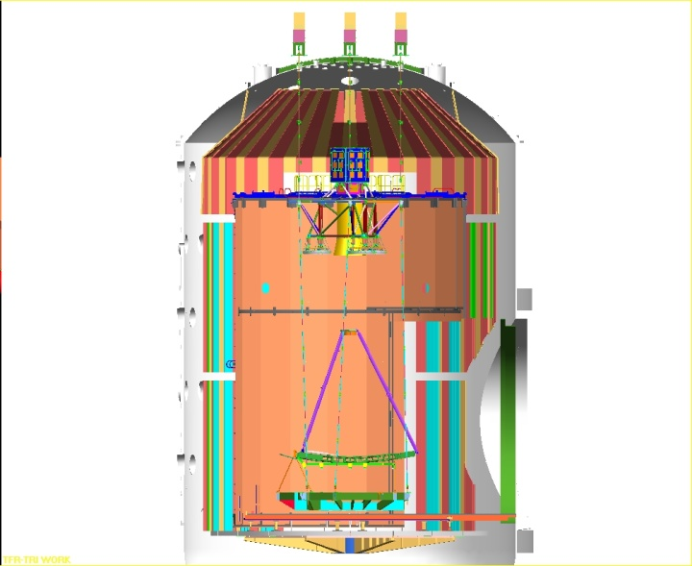
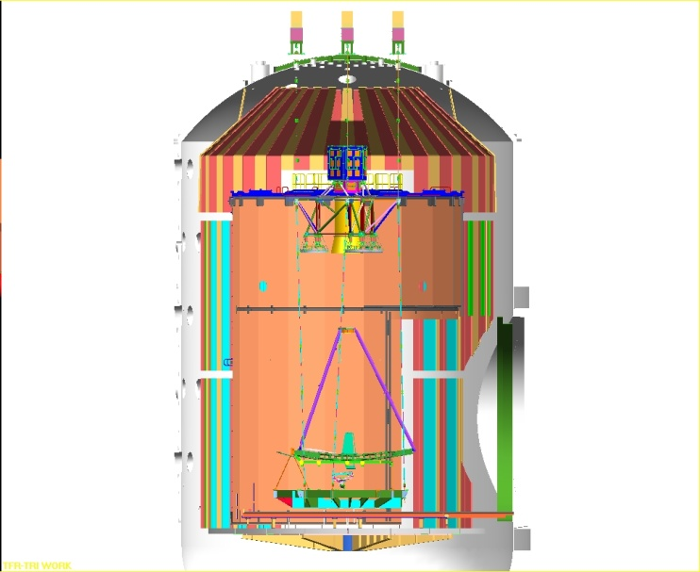
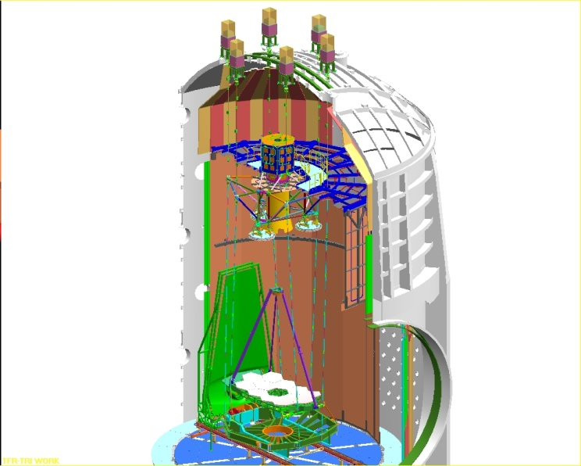
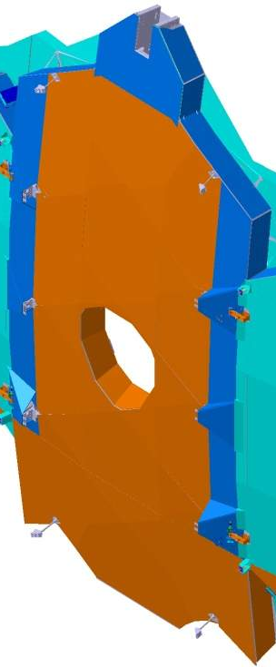
Pathfinder Cryo Tests Provide Invaluable Preparation
OGSE-1
OGSE-2
Pathfinder Thermal
PF Updated
to be more Flight Like
Checkout Optical GSE that has not seen cryo before: CoC test, Hanging Config, Photogrammetry
No flight hardware except spares
Dynamics and Thermal Distortion portion of PF Augmentation occur here
Checkout Pass and a half test with flight AOS and GSE source plate system
Uses BIA (or BIA-like) camera as SI simulator
Thermal GSE Checkout
(includes SVTS)
Dry run cooldown and warmup
Will allow risk reduction of some OTE Thermal Balance (design validation off the critical path)
23

Slide 24
Risk Reduction/Streamlining of OTIS Cryo Test
Pathfinder test series (OGSE1, OGSE2, Pathfinder Thermal) validates hardware, procedures, trains personnel
Additional subsystem cryo tests mitigate risk of finding thermal problems in the JSC test
MIRI cryo-cooler I&T flow now includes an end-to-end performance test against flight-like loads (at one point JSC OTIS test was only cryo-cooler end-to-end verification)
“Core 2” test is now planned to update the earlier thermal test of “Core” region (where connections pass through sunshield from warm spacecraft to cold telescope) and validate the thermal model of that region before the JSC OTIS test
JSC OTIS cryo-test shortened substantially vs. early plans (~90 days vs. >160 days)
Many activities not requiring thermal stability folded into cooldown, warmup periods; other test procedures scrubbed for essentials
Pathfinder Thermal and Core 2 tests permit elimination of 2nd thermal balance point for savings of several weeks in cryo timeline

Slide 25
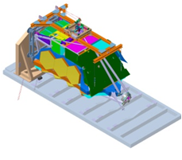
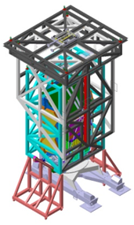
I&T Flow – Observatory (NG)
Receive OTIS
Integrate SCE and OTIS
Ambient Test
Dynamics Tests
Post- Dynamics Deployments
Post Dynamics Ambient Test
Receive SCE
Mechanical Mate
Electrical Integration
Functional deployments
Observatory Alignments
CST-2
EMC
GSEG-3
Reinstall SA
Acceptance Acoustic
Accept. Sine Vibe
Separation Shock
GAA, SA, RS 1st Motion
SMSS 1st Motion
OTE Wing & DTA Deploy
SS Deploy, Fold & Stow
Deployed alignments
CST-3
GSEG-4
Stowed Alignments
Receive LV PAF
Mate to LV
in BAF
Launch
Mass Props
& Ship Preps
Transport to CSG
Configure Observatory in S5C
Limited Functional Test
Fueling
in S5B
Mass
Lateral CG
Move to container
By ship from Space Park to CSG
Rotate to vertical
Move into clean tent
Remove contamination bag
Post ship inspection
Limited Functional
GSEG End-To-End Test
Air Barge to S5B
Load propellants
Mate to LV PAF
Red Tag /Green Tag
CCU3 to BAF
Mate to LV
LVIF Test

Slide 26
Summary
The Integration, Test, and Verification of a huge, cryogenic, segmented, deployable observatory is very challenging
A great deal of planning has been done for the many activities required, and the test equipment needed to support them is well into development
Great efforts will be made to streamline and reduce the risk (technical, cost/schedule) of the major activities
As always, flexibility is required in the I&T program to work around issues that arise and continue to make progress
We look forward to delivering a spectacular, well tested and verified observatory for launch in 2018
Launch

